Slide 1
Decomposers

Slide 2



Slide 3
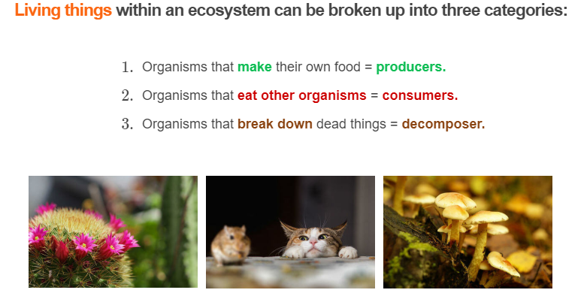

Slide 4

Producers include plants and algae!
Other organisms can consume producers to gain energy from them.
But hang on, where do producers get their energy from?

Slide 5

Most producers get their energy from the Sun. They use the energy from the Sun to make food for themselves.
Photosynthesis is the name of the process used by producers to turn the Sun's energy into food.

Slide 6
During photosynthesis, producers take in carbon dioxide and water.
They use the Sun's energy to convert the carbon dioxide (CO_{2​}) and water into sugar, called glucose, and oxygen.
Producers use glucose as food. The oxygen they produce can be used by other organisms to breathe!
Photosynthesis equation:

Slide 7
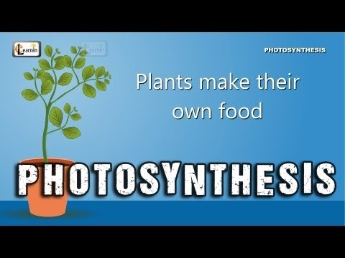

Slide 8

Now that we know what producers are, let's check out the next category of organisms: decomposers!

Slide 9
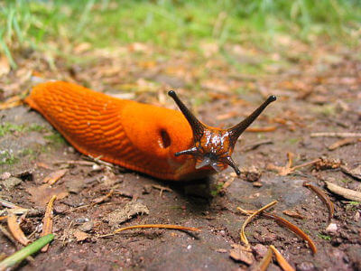
Decomposers are organisms that gain energy by breaking down dead or decaying organisms.
Some of the most common decomposers are worms, slugs, bacteria and fungi like mushrooms.

Slide 10
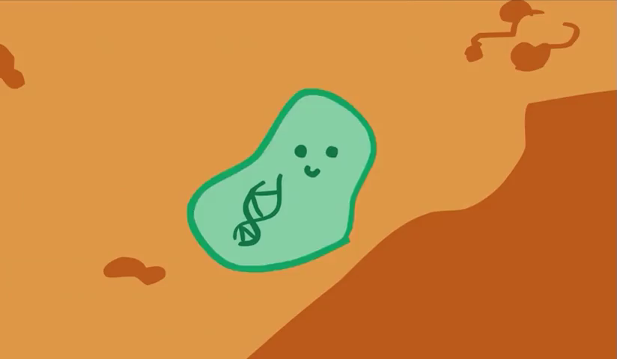
Microorganisms play a special role in decomposition.
Microorganisms include all organisms too small to be seen with the naked eye. They can be found almost anywhere on Earth! Even though we can't see them, they have a huge impact on us and the environment!
Bacteria are an example of microorganisms.

Slide 11
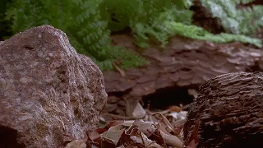
As they break down dead or decaying organisms, decomposers return nutrients to the soil.
These nutrients can be used by producers to grow!
Fungi are especially good at returning nutrients to the soil.

